Slide 1
Illustrator Assignment

Slide 2
Introduction to Adobe Illustrator Interface and Workspace
Theory Assignment:
Overview of Adobe Illustrator
Understanding the Workspace
Setting Up a New Document

Slide 3
Introduction to Adobe Illustrator Interface and Workspace
Overview of Adobe Illustrator
Explain the main uses of Illustrator in the design industry, such as logo creation, vector illustrations, and icon design.

Slide 4
Explain the main uses of illustrator in the design industry, such as logo creation, vector illustrations, and icon design.
Illustrator is widely used in the design industry for:
Logo Creation: Crafting scalable, high-quality logos.
Vector Illustrations: Designing detailed, resolution-independent graphics.
Icon Design: Creating clean, customizable icons.
Typography: Customizing and creating type-based designs.
Infographics: Designing visually appealing data presentations.
Print Design: Producing brochures, posters, and business cards.
Web Graphics: Developing web-friendly vector assets.

Slide 5
Introduction to Adobe Illustrator Interface and Workspace
Understanding the Workspace
Define key elements of the Illustrator workspace: artboards, panels, tools, and properties.
Describe the purpose of the Layers panel and how it helps manage complex designs.

Slide 6
Define key elements of the illustrator workspace: artboards, panels, tools, and properties.
Artboards: Editable canvas areas for design projects.
Panels: Dockable sections for layers, colors, and properties.
Tools: Toolbar for creating and editing graphics.
Properties: Context-sensitive options for selected objects or tools.

Slide 7
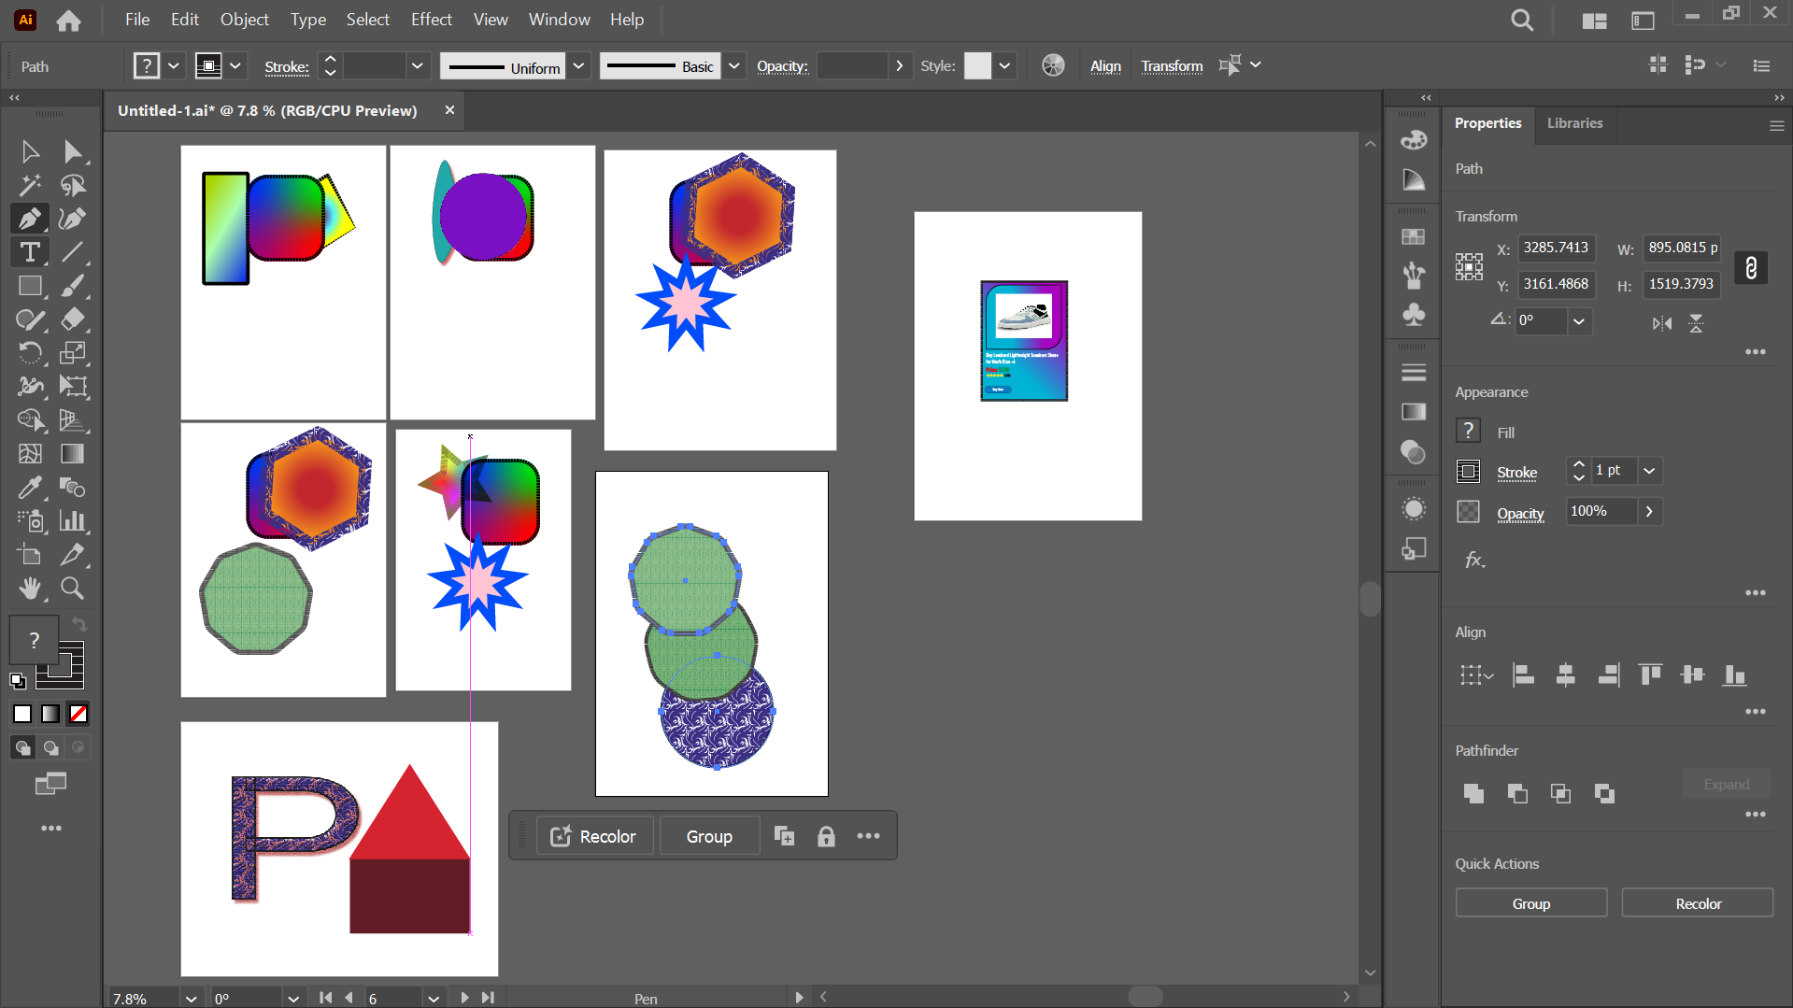
Define key elements of the illustrator workspace: artboards, panels, tools, and properties.

Slide 8
Describe the purpose of the layers panel and how it helps manage complex designs.
The Layers panel in Illustrator serves as a powerful tool for managing complex designs by:
Organizing Elements: Separates objects into layers for a structured workflow.
Visibility Control: Toggle layer visibility to focus on specific elements.
Locking Layers: Prevents accidental edits to specific elements.
Grouping Objects: Enables grouping and sub-layer creation for better hierarchy.

Slide 9
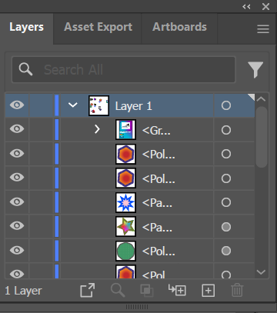
Describe the purpose of the layers panel and how it helps manage complex designs.
Editing Efficiency: Select and edit individual objects without affecting others.
Layer Reordering: Adjust stacking order to control object overlap.
Isolation Mode: Focuses on specific layers or objects for detailed editing.

Slide 10
Introduction to Adobe Illustrator Interface and Workspace
Setting Up a New Document
Explain the steps to create a new document in Illustrator, including selecting document dimensions, orientation, and color mode.
Describe the difference between RGB and CMYK color modes and when to use each.

Slide 11
Explain the steps to create a new document in illustrator, including selecting document dimensions, orientation, and color mode.
Launch Illustrator: Open the application.
Create New Document: Click File > New or press Ctrl+N.
Choose Preset: Select a template or custom settings in the New Document window.
Set Dimensions: Enter width and height values.
Select Orientation: Choose portrait or landscape.
Pick Color Mode: Select RGB for digital or CMYK for print.
Adjust Bleed (Optional): Set bleed margins if needed.
Create Document: Click Create to open the new artboard.

Slide 12
Describe the difference between RGB and CMYK color modes and when to use each.
RGB(Red, Blue, Green)
CYMK(Cyan, Magenta, Yellow, Black)
Used for digital designs like websites, apps, and screens.
Produces vibrant colors by combining light.
Best for on-screen use as screens emit light.
Use RGB for digital projects and designs meant for screens.
Used for print designs like brochures, posters, and packaging.
Uses ink to subtract light, suitable for physical media.
Ensures accurate color reproduction in printing.
Use CMYK for designs intended for printing to ensure proper color output.

Slide 13
Introduction to Adobe Illustrator Interface and Workspace
Practical Assignment:
Workspace Exploration
Customizing the Workspace

Slide 14
Introduction to Adobe Illustrator Interface and Workspace
Customizing the Workspace
Screenshot your customized workspace layout and explain why you arranged the tools in this way.

Slide 15
Working with Shapes and the PenTool
Theory Assignment:
Basic Shape Tools
The Pen Tool
Pathfinder Tool
The Pencil Tool

Slide 16
Introduction to Adobe Illustrator Interface and Workspace
Basic Shape Tools
Describe the Rectangle, Ellipse, Polygon, and Star tools, explaining how each shape can be used in designs.
Explain how the Shape Builder tool helps combine and manipulate shapes.

Slide 17
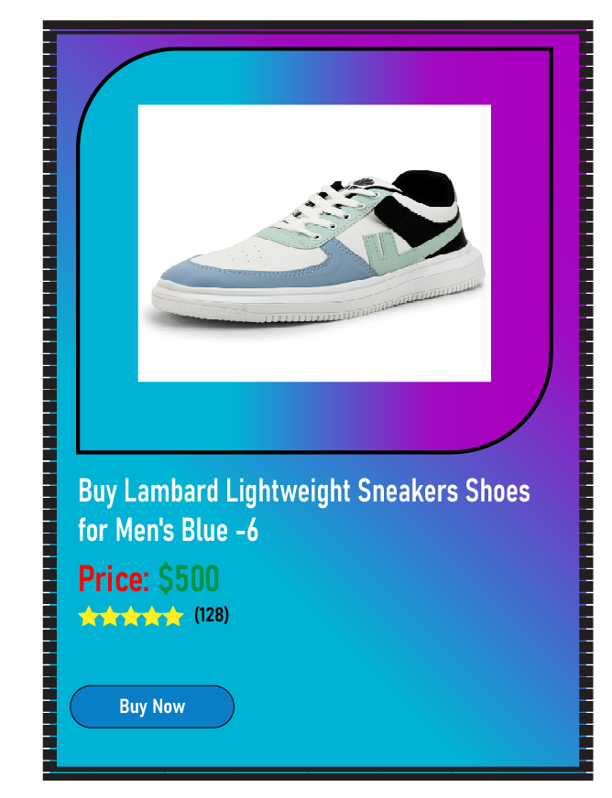
Describe the rectangle, ellipse, polygon, and star tools, explaining how each shape can be used in designs.
Rectangle Tool: Creates squares or rectangles; used for backgrounds, buttons, and layout structures.
Ellipse Tool: Draws circles or ovals; great for logos, icons, and decorative elements.
Polygon Tool: Makes polygons with adjustable sides; ideal for badges, charts, and unique shapes.
Star Tool: Creates stars with customizable points; used for highlights, decorative elements, or branding.

Slide 18
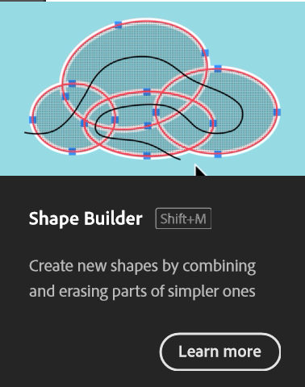
Explain how the shape builder tool helps combine and manipulate shapes.
Combining Shapes: Drag across overlapping areas to merge them into a single shape.
Subtracting Areas: Hold Alt (Windows) or Option (Mac) and click unwanted areas to remove them.
Creating New Shapes: Isolate specific segments by selecting and splitting overlapping shapes.
Streamlining Workflows: Eliminates the need for complex path operations with intuitive interactions.

Slide 19
Introduction to Adobe Illustrator Interface and Workspace
The Pen Tool
Define the Pen tool and describe its purpose in creating custom shapes and paths.
Explain the difference between anchor points, handles, and paths.

Slide 20
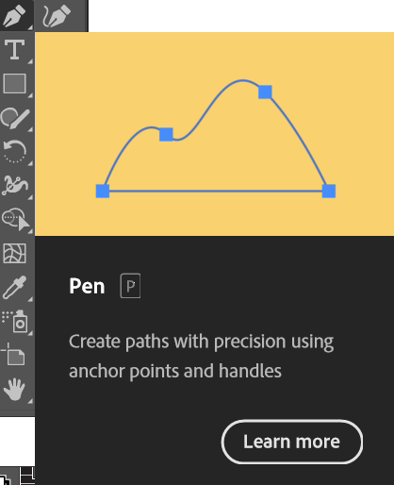
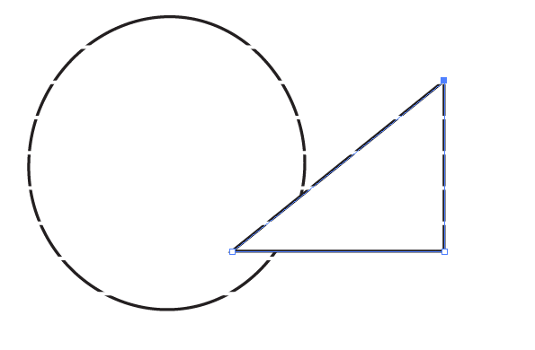
Define the pen tool and describe its purpose in creating custom shapes and paths.
The Pen tool is a vector-based drawing tool used to create precise paths and shapes.
It allows you to create smooth curves and straight lines by placing anchor points and manipulating their handles. This makes it ideal for creating logos, illustrations, and complex selections.

Slide 21
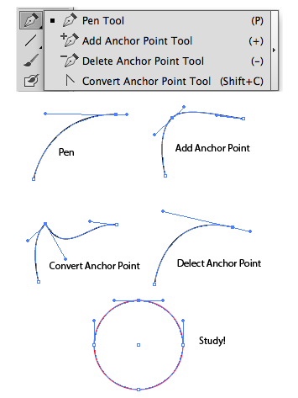
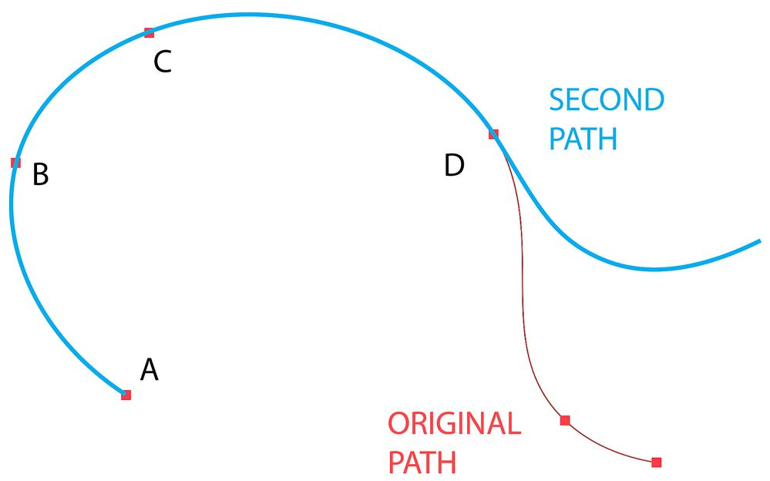
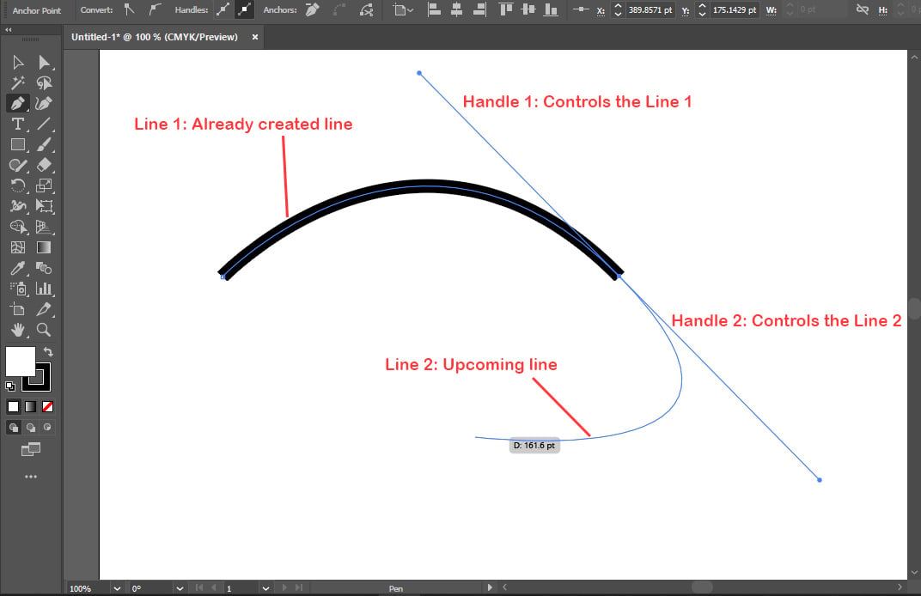
Explain the difference between anchor points, handles, and paths.
Anchor Points: These are the corner points of a path. They determine the shape and direction of the path.
Handles: These are the lines that extend from anchor points. They control the curvature of the path between anchor points.
Paths: These are the lines that connect anchor points. They form the outline of a shape.

Slide 22
Introduction to Adobe Illustrator Interface and Workspace
Pathfinder Tool
Explain how the Pathfinder tool is used for combining and subtracting shapes.
Describe the differences between the Unite, Minus Front, Intersect, and Exclude options in Pathfinder.

Slide 23
Explain how the pathfinder tool is used for combining and subtracting shapes.
The Pathfinder tool in Adobe Illustrator is a powerful tool for combining and subtracting shapes.
Combining Shapes:
Unite: This operation merges multiple shapes into a single, unified shape. The resulting shape will have the combined area of all the selected shapes.
Add: This operation is similar to Unite, but it preserves the individual shapes within the group. This allows you to edit the individual shapes later without affecting the combined shape.

Slide 24
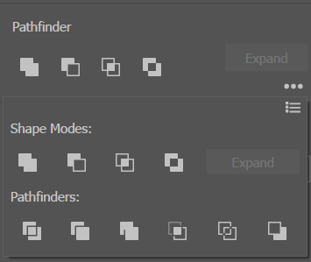
Explain how the pathfinder tool is used for combining and subtracting shapes.
Subtracting Shapes:
Minus Front: This operation subtracts the topmost shape from the shape below it. This is useful for creating cutouts and other complex shapes.
Intersect: This operation creates a new shape from the overlapping areas of two or more shapes.
Exclude: This operation creates a new shape from the non-overlapping areas of two or more shapes

Slide 25
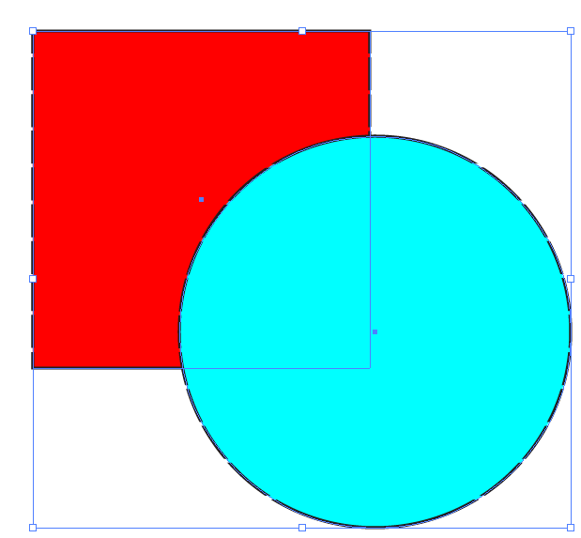
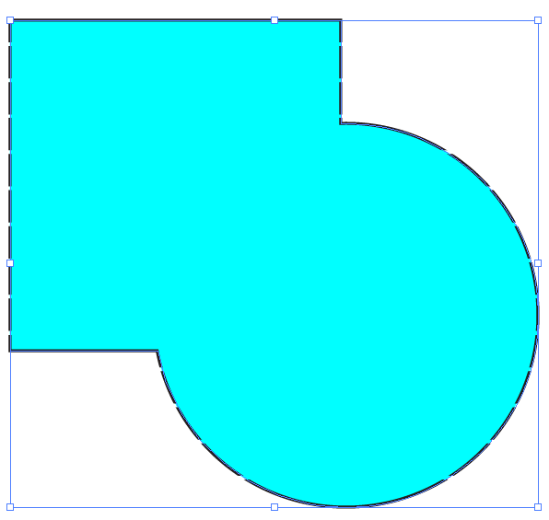
Describe the differences between the unite, minus front, intersect, and exclude options in pathfinder.
Unite:
Purpose: Combines multiple shapes into a single, unified shape.
Result: A single shape with the combined area of all selected shapes.
Example: Combining several smaller shapes to form a larger, more complex shape.
Before
After

Slide 26
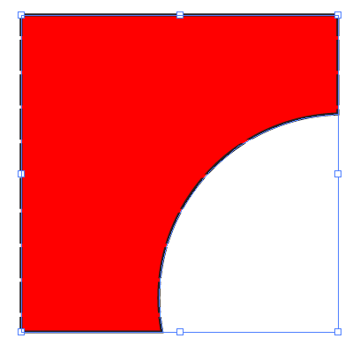
Describe the differences between the unite, minus front, intersect, and exclude options in pathfinder.
Minus Front:
Purpose: Subtracts the topmost shape from the shape below it.
Result: Creates a cutout or removes a portion of the bottom shape based on the shape of the topmost shape.
Example: Creating an arc in a rectangle by placing a circle on top and using Minus Front.
Before
After

Slide 27
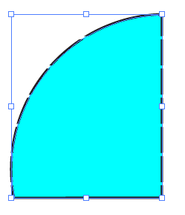
Describe the differences between the unite, minus front, intersect, and exclude options in pathfinder.
Intersect:
Purpose: Creates a new shape from the overlapping areas of two or more shapes.
Result: A shape that only includes the areas where the selected shapes intersect.
Example: Creating a custom shape by overlapping rectangles and circle using Intersect to keep only the overlapping area.
Before
After

Slide 28
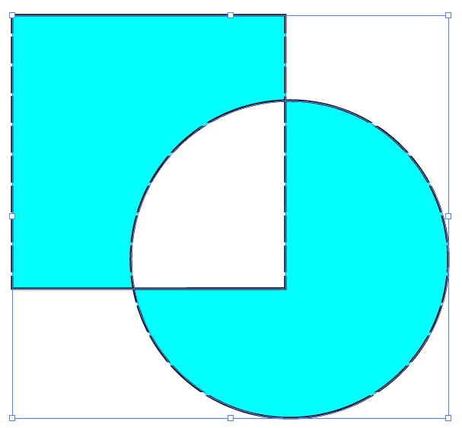
Describe the differences between the Unite, Minus Front, Intersect, and Exclude options in Pathfinder.
Exclude:
Purpose: Creates a new shape from the non-overlapping areas of two or more shapes.
Result: A shape that includes all parts of the selected shapes except for the areas where they overlap.
Example: Creating a shape that is the opposite of an intersection, keeping the parts of the shapes that don't overlap.
Before
After

Slide 29
Introduction to Adobe Illustrator Interface and Workspace
The Pencil Tool
Define the Pencil tool and describe its purpose in creating custom Typeface modification

Slide 30
Define the pencil tool and describe its purpose in creating custom typeface modification.
The Pencil tool in Illustrator is used for freehand drawing. While not directly for typeface editing, it helps in:
Sketching initial ideas: Capturing organic shapes for inspiration.
Creating custom brushes: Adding texture and personality to type.
Vectorizing handwritten fonts: Converting handwritten characters into editable vectors.

Slide 31
Working with Shapes and the PenTool
Practical Assignment:
Creating Custom Shapes with the Pen Tool
Shape Builder Exercise
Pathfinder Tool Practice
Pencil Tool Practice

Slide 32
Introduction to Adobe Illustrator Interface and Workspace
Creating Custom Shapes with the Pen Tool
Create a complex design using overlapping basic shapes (circles, rectangles, etc.).
Use the Shape Builder tool to merge or subtract parts of the shapes, creating a unique composition.

Slide 33
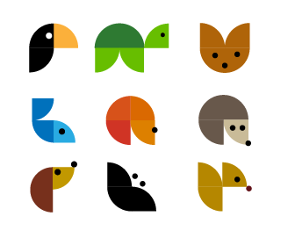
Using the pen tool, create a simple icon (e.g., A house or tree) by combining shapes and paths. Apply colors and strokes to the design, experimenting with various stroke weights and fills.

Slide 34
Introduction to Adobe Illustrator Interface and Workspace
Shape Builder Exercise:
Create a complex design using overlapping basic shapes (circles, rectangles, etc.).
Use the Shape Builder tool to merge or subtract parts of the shapes, creating an unique composition.

Slide 35
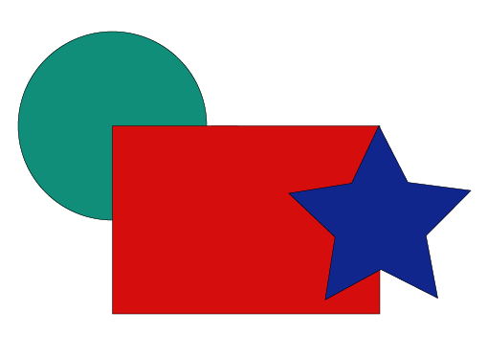
Create a complex design using overlapping basic shapes (circles, rectangles, etc.).

Slide 36
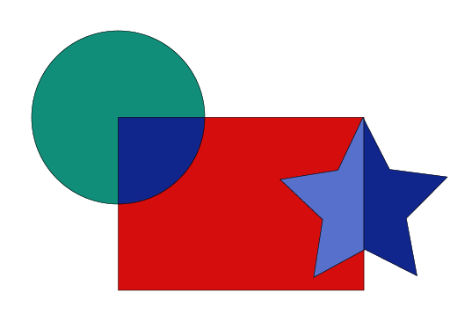
Use the Shape Builder tool to merge or subtract parts of the shapes, creating an unique composition.

Slide 37
Introduction to Adobe Illustrator Interface and Workspace
Pathfinder Tool Practice
Design a logo by combining and subtracting shapes using the Pathfinder tool.
Apply different colors and gradients to each part of the logo for added depth.

Slide 38

Design a logo by combining and subtracting shapes using the Pathfinder tool.

Slide 39

Apply different colors and gradients to each part of the logo for added depth.

Slide 40
Thank You !

